Slide 1
Disaster-Free Deployment: Automate All The Things
David Simner
Notes:
About
Southern Fried Agile (October 2013)
David Simner
Software Engineer
Red Gate

Slide 2
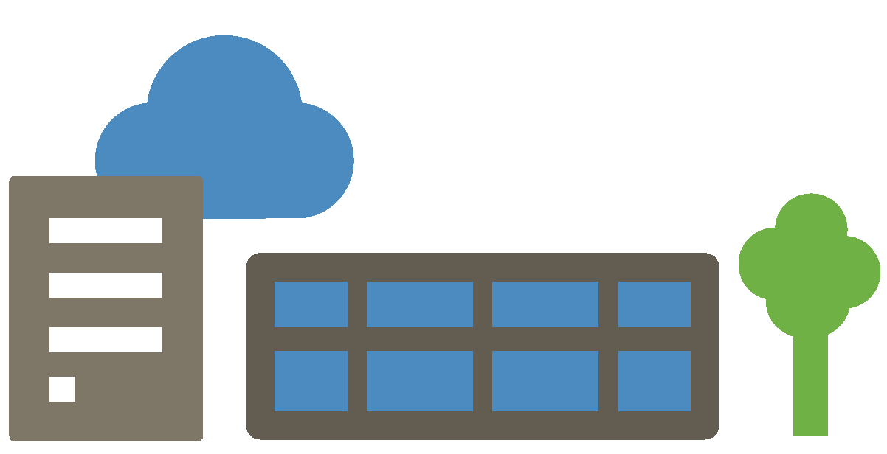

Slide 3
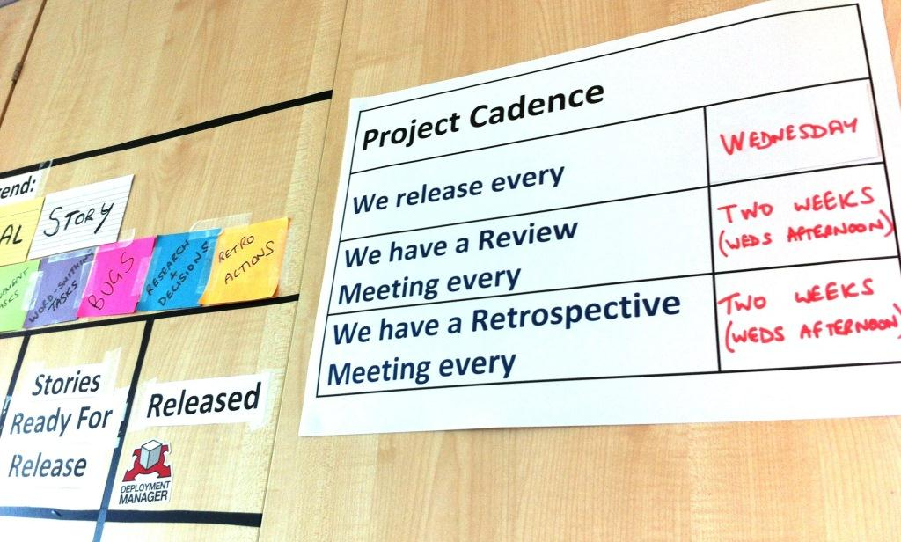

Slide 4
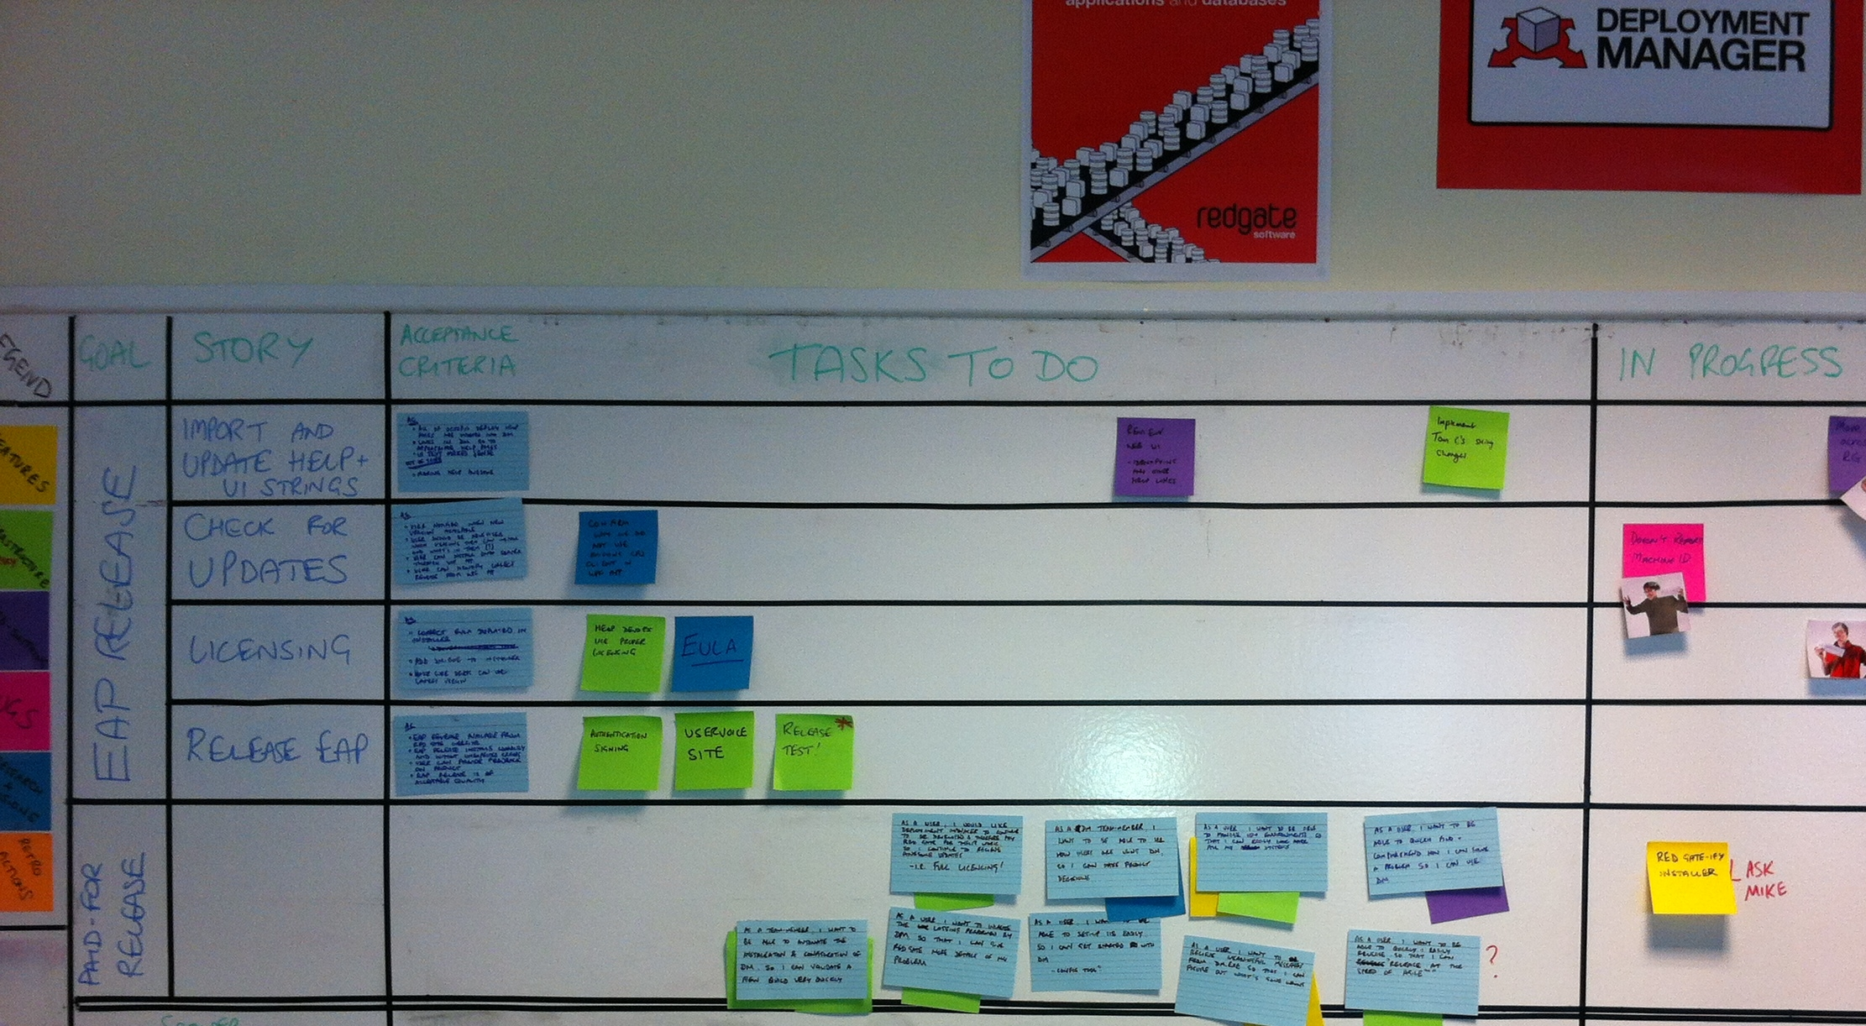

Slide 5
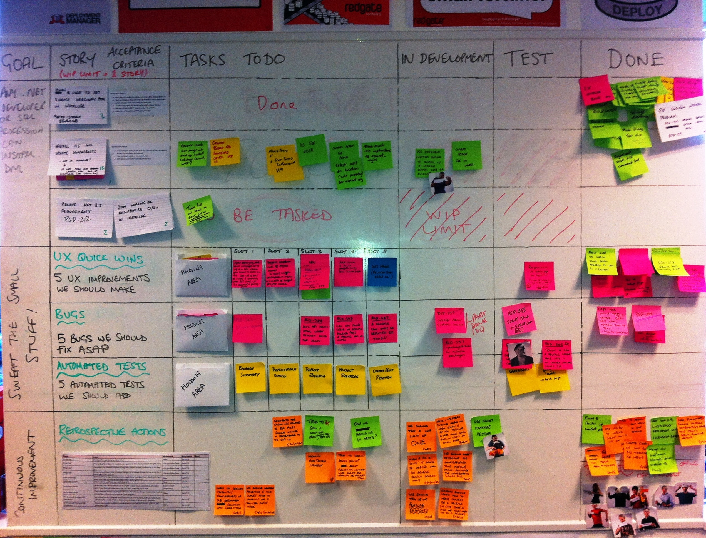

Slide 6
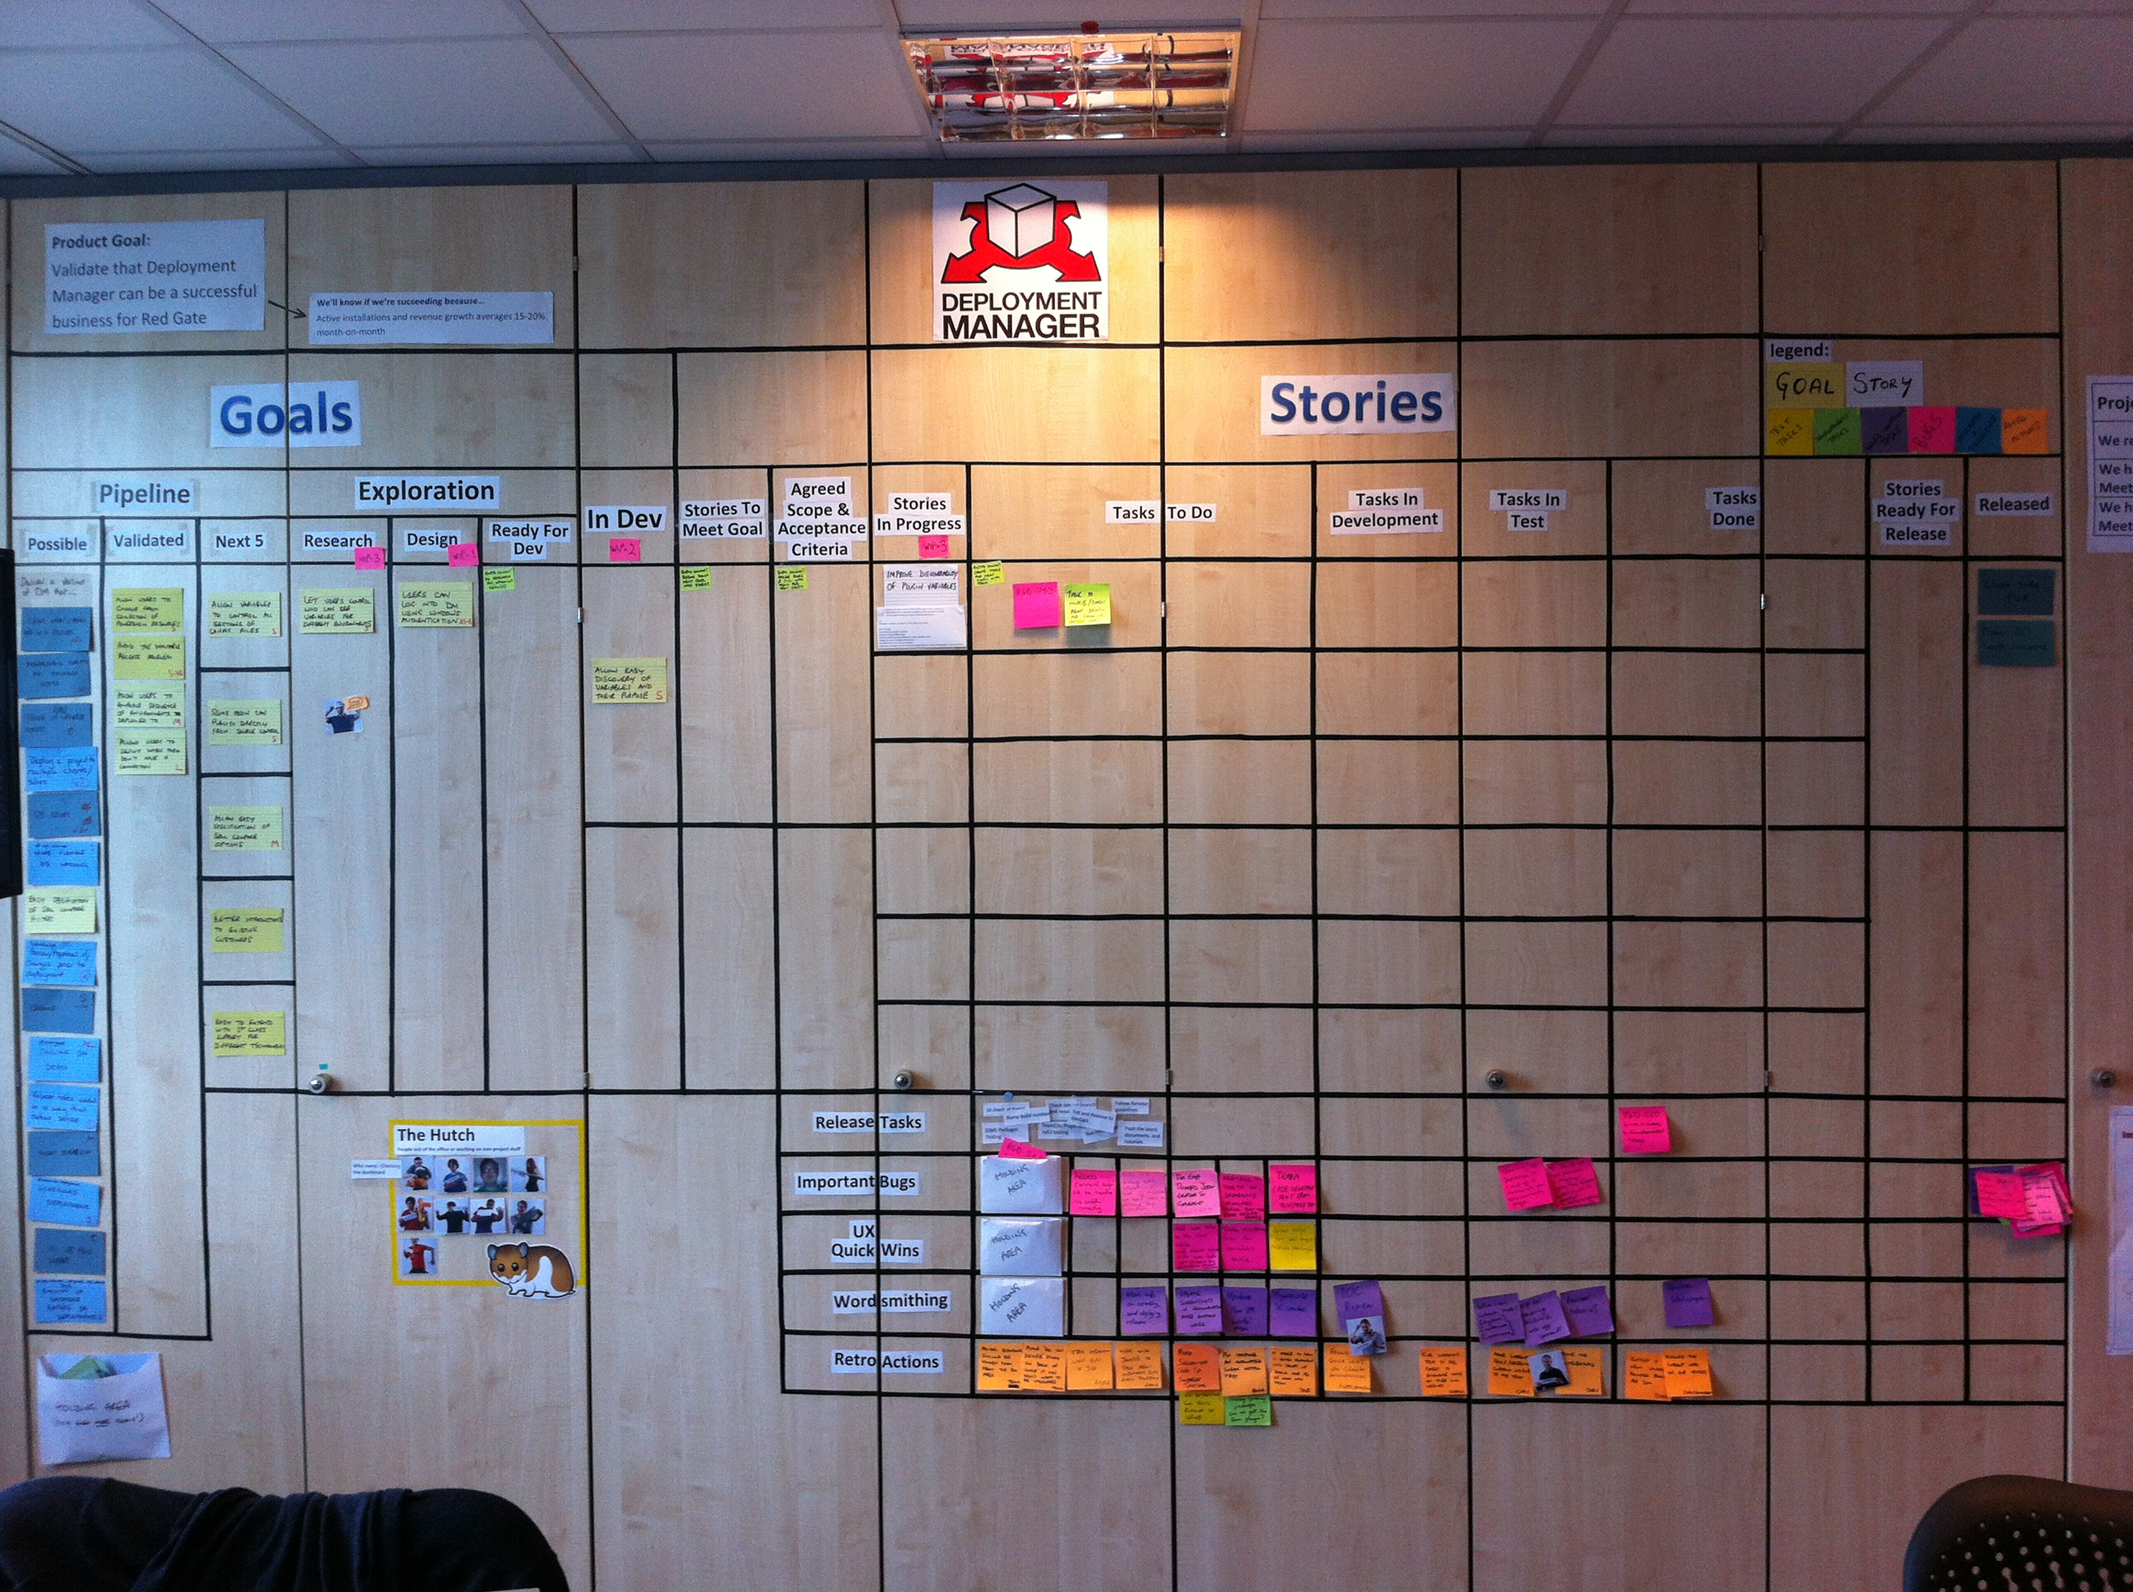
Notes:
Explain the bloat on the left-hand side

Slide 7
Code inventory
Features or bug fixes (i.e. code) that have been written, but not yet shipped, are not delivering user value.
Notes:
Not only are bug fixes sitting on the shelf, but the developers’ mental model of the software is in the future, so they struggle to help support engineers. Both of these factors coupled together leads to a bad support experience.
Releasing every week makes it obvious when you’re not finishing stories fast enough, because you’ve only got bug fixes to ship!

Slide 8
First-mover advantage
Getting users’ mindshare is important, and being second to market can be devastating!

Slide 9
Lean
Furthermore, you aren’t getting feedback on code that has not yet shipped.
What if you’re going down the wrong path? How would you know?

Slide 10
Time-consuming
How long does it take to release?
Notes:
Opportunity cost

Slide 11
Risk
Probability and cost of mistakes?
Notes:
Error-prone

Slide 12
Right person being available
What if Dave is in Paris?
I mean yes, the macaroons he’ll bring back will be super-tasty, but that doesn’t really help the users when we can’t ship that bug fix…
Notes:
Knows process, passwords, etc…

Slide 13
Release management tools
You need a release management tool.
We happen to have one that’s free, and okay I’m biased, but I happen to think it’s pretty good, and there are others out there too :-)

Slide 14
Demo

Slide 15
</talk> any questions?

